Slide 1
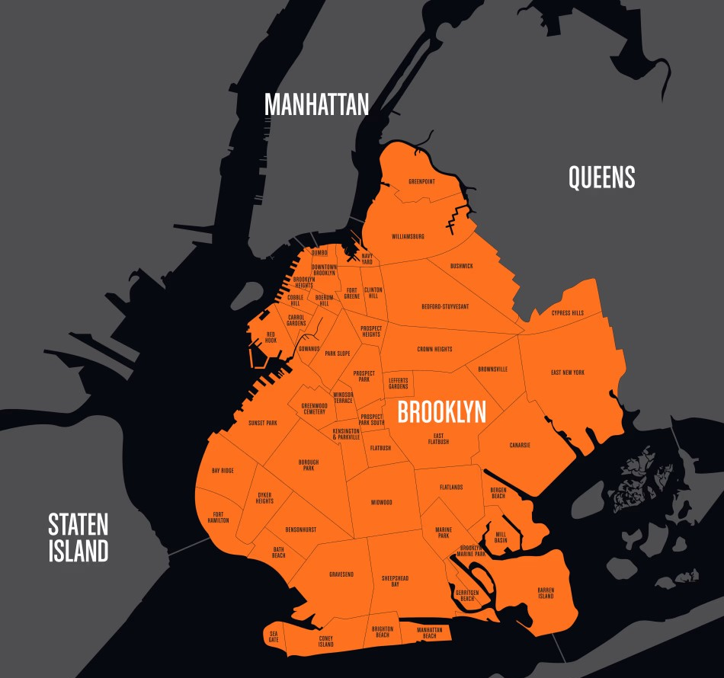
Moving Переезд
Please don't hate me for my English : )

Slide 2
Project Goal:
To identify people who are likely to move to a new neighborhood based on their characteristics.
1) Set up and configure Oracle VM on Windows 11, installing Ubuntu 20.04 LTS. 2) Set up Mysql database via terminal on Ubuntu. (with postgres the setup took longer) 3) Write a Python script in Jupyter Notebook to connect to the Mysql database. 4) Upload generated data into the database tables (data about people who have already moved and those who have not yet moved).
5) Merge the data from both tables and create a score to predict the likelihood of moving.
6) Output the score results in a Power BI report.

Slide 3
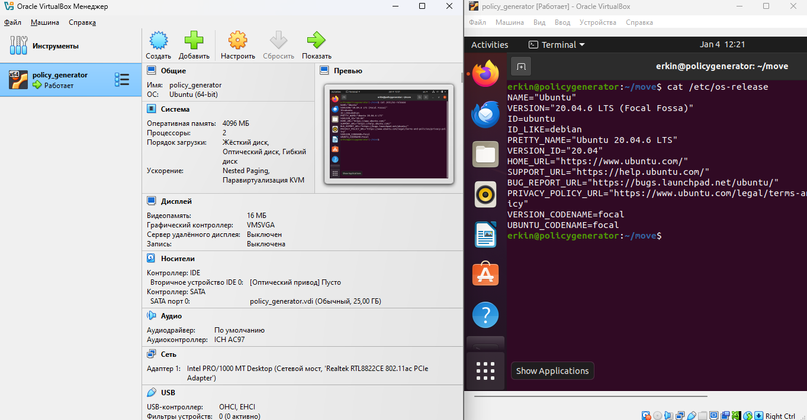
Set up and configure Oracle VM on Windows 11, installing Ubuntu 20.04 LTS.
RAM 4GB / 2 CPU / 16 MB GPU

Slide 4
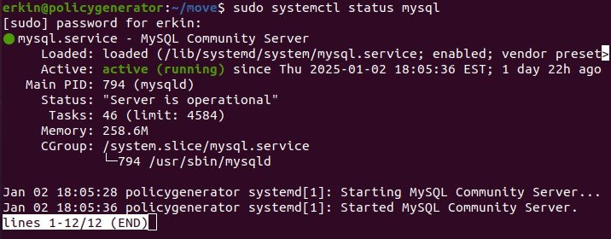
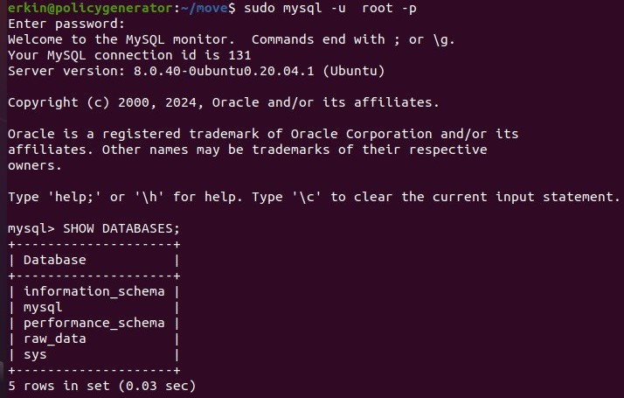
Set up Mysql database via terminal on Ubuntu.
Deployed the Mysql
database.
Created a database named raw_data

Slide 5
CREATE TABLE raw_data.people_no_move (
person_id INT,
name VARCHAR(255),
gender VARCHAR(10),
original_district VARCHAR(255),
new_district VARCHAR(255) DEFAULT NULL,
move_date DATE DEFAULT NULL,
age INT,
move_month INT DEFAULT NULL,
move_year INT DEFAULT NULL
);
CREATE TABLE raw_data.people (
person_id INT,
name VARCHAR(255),
gender VARCHAR(10),
original_district VARCHAR(255),
new_district VARCHAR(255) DEFAULT NULL,
move_date DATE DEFAULT NULL,
age INT,
move_month INT DEFAULT NULL,
move_year INT DEFAULT NULL
);
I created 2 tables in the mysql database that moved and those that did not move and I need to understand where they will most likely move to

Slide 6
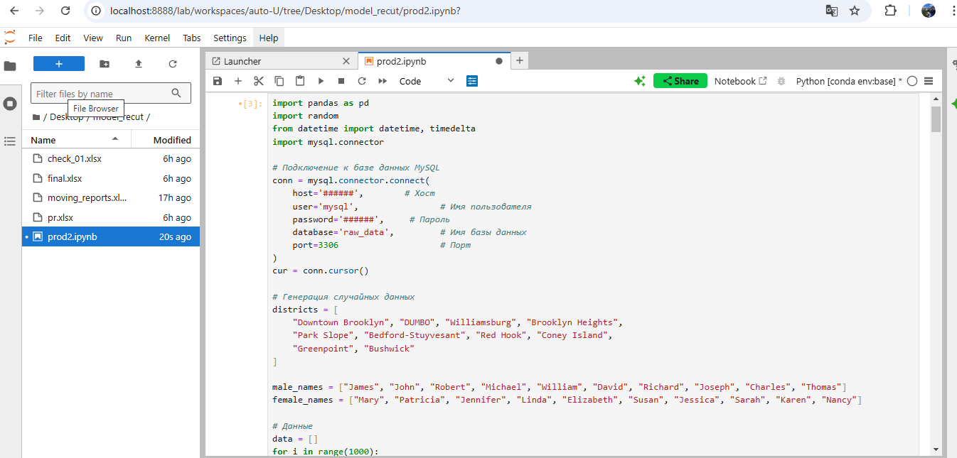
Write a Python script in Jupyter Notebook to connect to the Mysql database.
I write to the gpt chat so that it generates data for me on people who moved from one area to another
with jup-lab I connect to the mysql database and use the connection modules and also generate data in the created tables

Slide 7
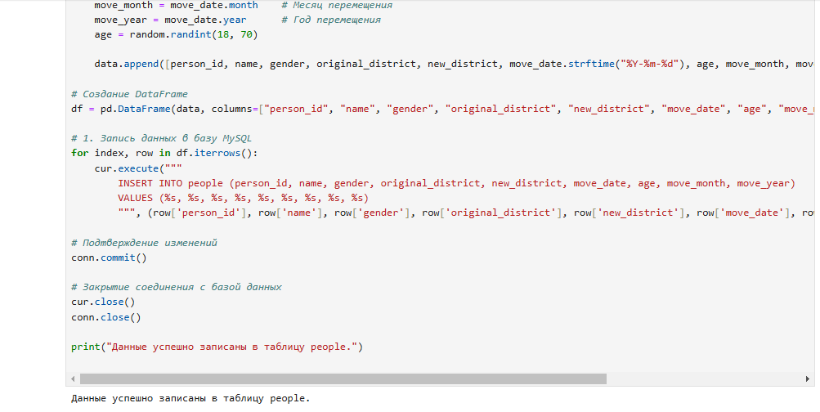
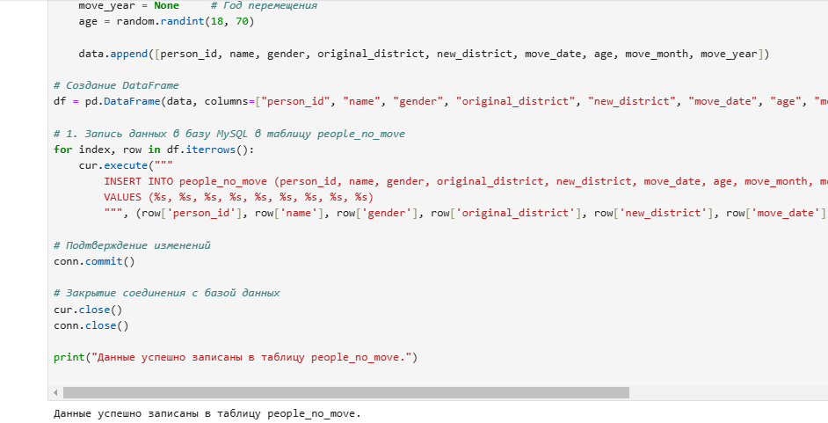
write the generated data into these created tables

Slide 8
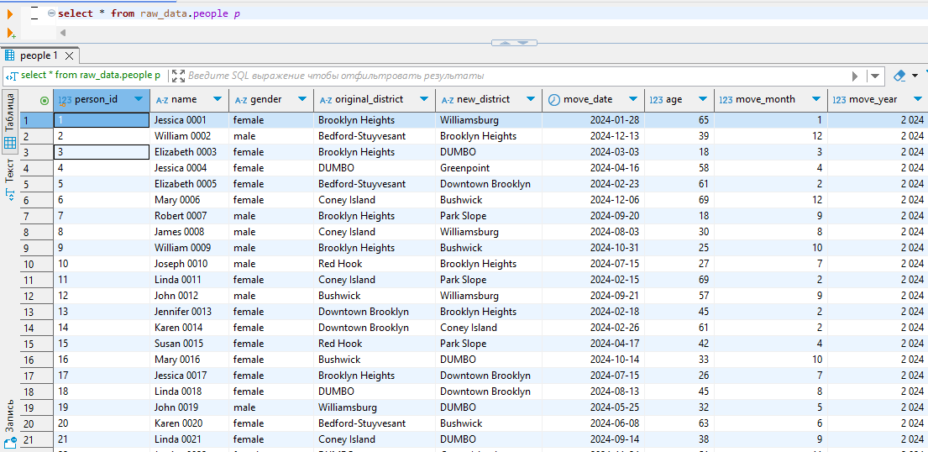
now with the sql script we will see the contents of the tables into which we have uploaded the generated data
I use Dbeaver , here we see the moves by characteristics(age,male and so on)

Slide 9
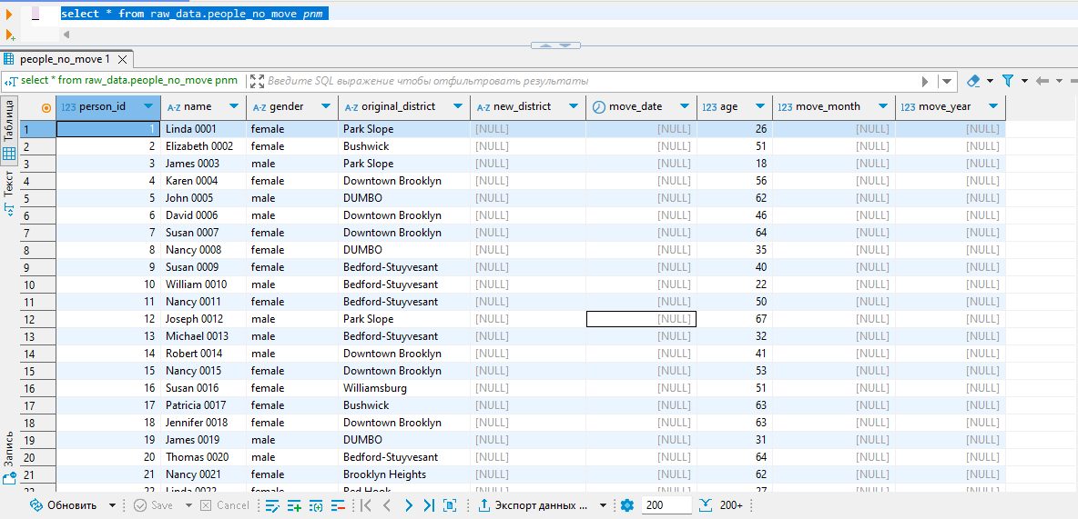
and here is data on the same columns, only these people have not moved yet

Slide 10
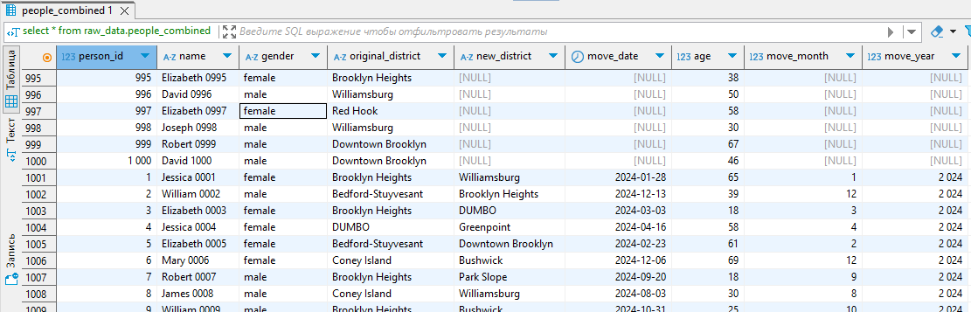
CREATE TABLE raw_data.people_combined AS
SELECT *
FROM raw_data.people_no_move
UNION ALL
SELECT *
FROM raw_data.people;

Slide 11
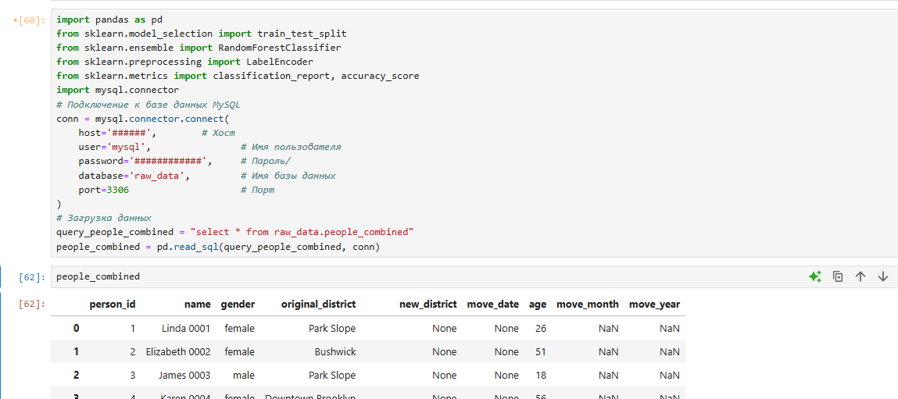
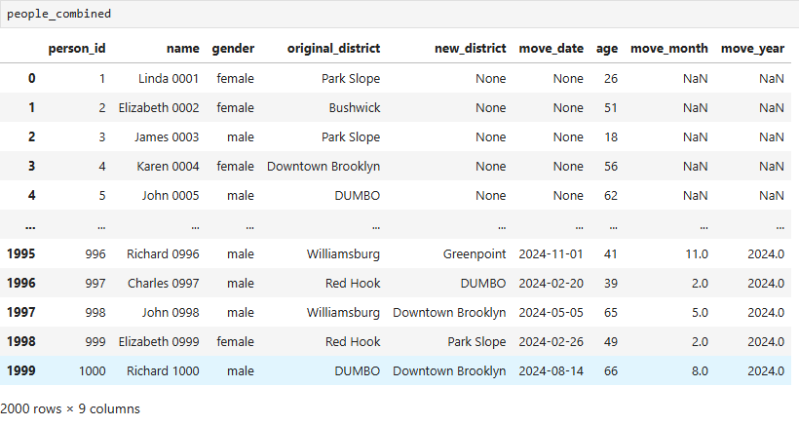
let's read the raw_data.people_combined table via python code for the data model

Slide 12
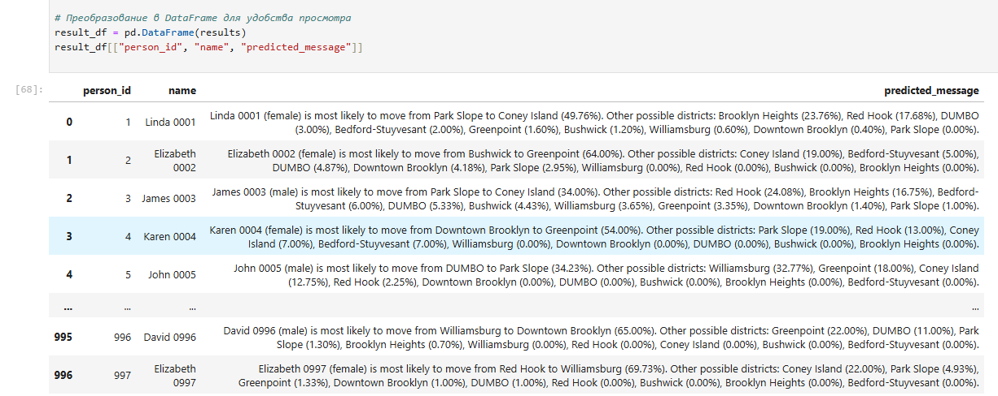
I asked ChatGpt to write solutions using the random forest model, since this model is more suitable for our small database, since 2000 lines is not that much.
Let's get straight to the result

Slide 13
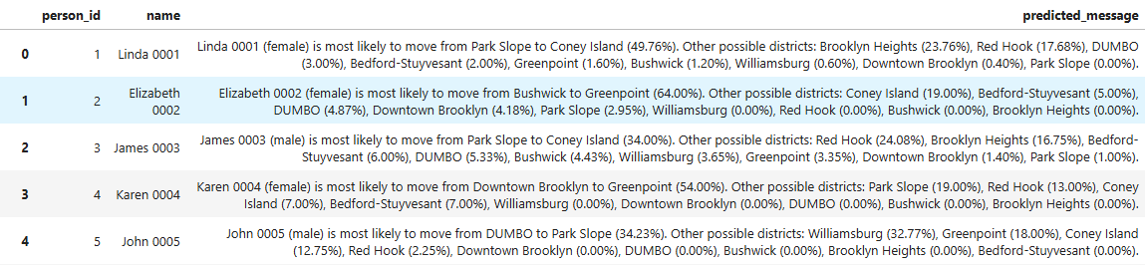
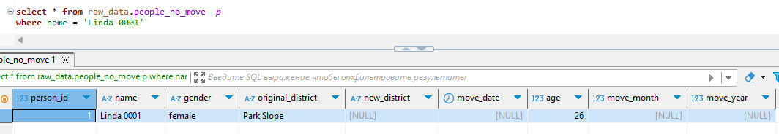
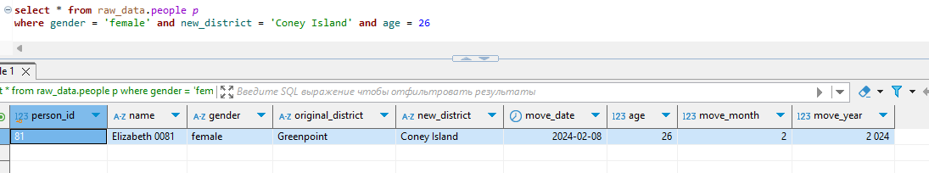
According to Linda, we see that the model predicted the top first Coney Island (since age and gender point to Elizabeth who moved to Coney Island with the same characteristics (age,gender))

Slide 14
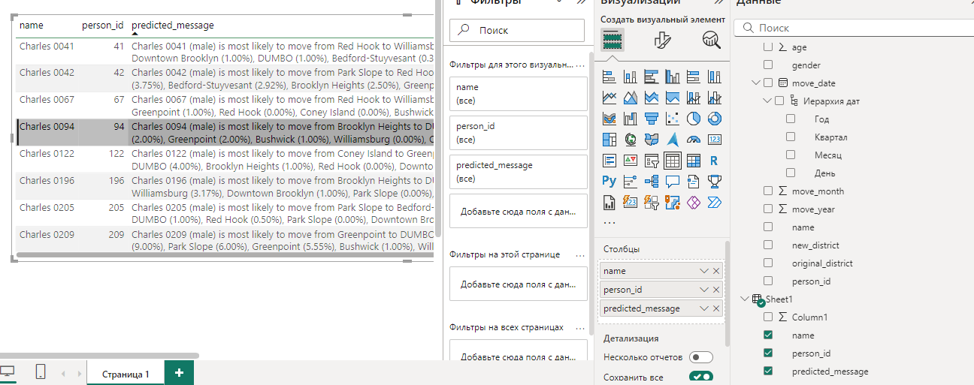
via power bi we connect to the final data (excel or write to the database)
Came to a conclusion on the power bi page. In general, yes, I actively used the AI ​​chat, but this did not prevent me from getting to analytics and signboards as soon as possible.
I also thought that this analytics needs to add data related to geo and also data on managers who sell well and reward them, different opportunities to observe.

Slide 15
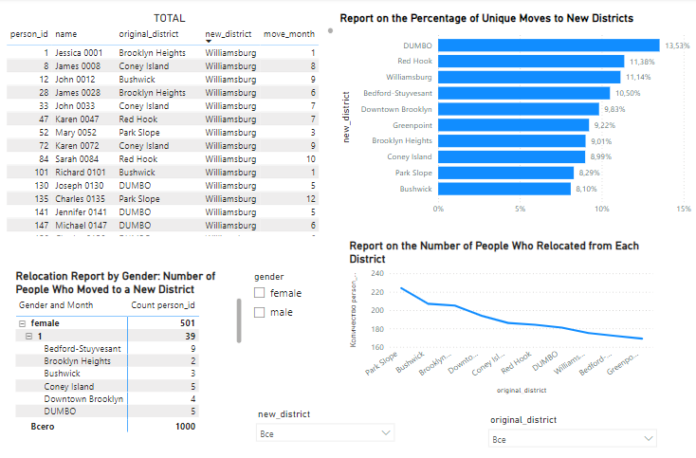
here I show how I made mini analytics in POWER BI based on data: slices, tables, dashboards. I didn't add the link because the license expired:)

